Slide 1
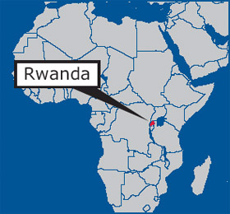
Rwanda:
Background Information
Rwanda is a tiny country. You could fit 7 Rwandas inside Oklahoma
.
Hotel Rwanda
explains ethnic strife
http://www.pepfar.gov/press/84649.htm

Slide 2
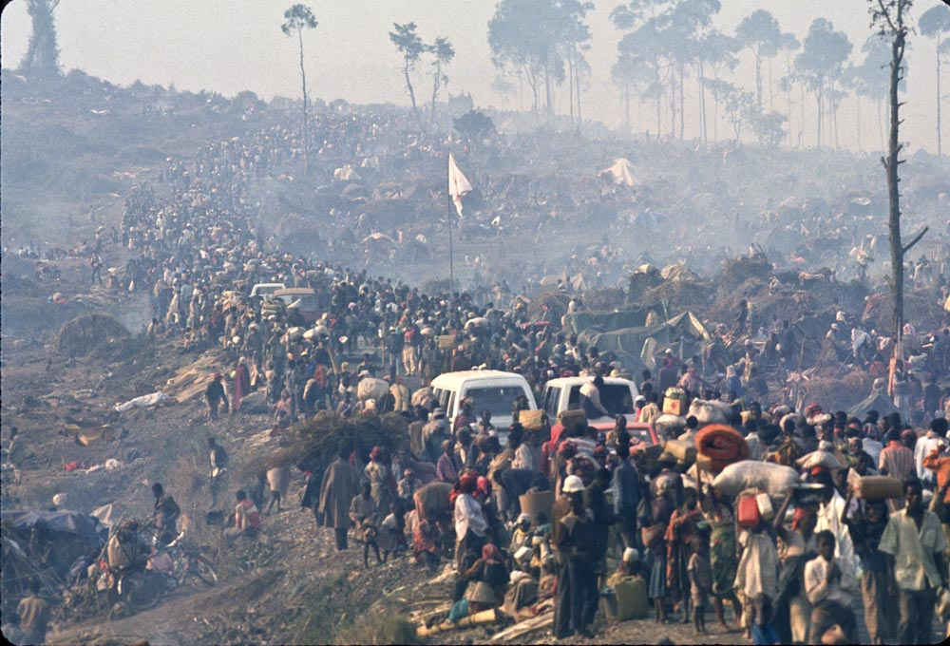
In April 1994, Hutus in Rwanda began killing Tutsi men, women, & children. This lasted 3 months.
Hotel Rwanda: Cut the tall trees
http://www.gregmarinovich.com/BLOG/wp-content/uploads/2011/11/RwandaGM20004.jpg

Slide 3
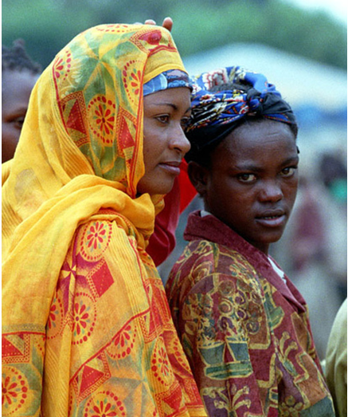
In Rwanda, over 95% of people are ethnically Hutu or Tutsi
Tutsi
Hutu
http://www.flickr.com/photos/charliemoon2007/1225960136/

Slide 4
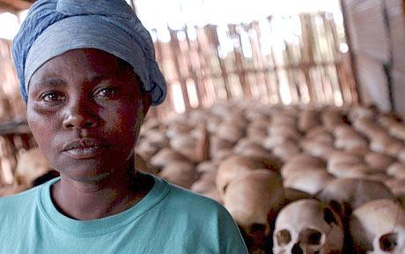
By the end of the murders, almost one million Tutsis were dead. Three-fourths of the Tutsis in Rwanda were dead.
Hutus who were viewed as “soft” on Tutsis were also murdered
Notes:
http://www.rutherfordschools.org/rhs/library/lib/librarymediacenter/ebooks.html

Slide 5
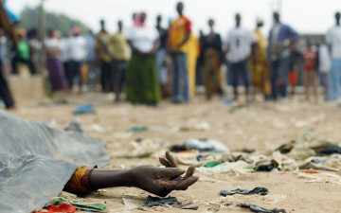
Imagine the entire population of Oklahoma City or Tulsa being slaughtered over a period of three months
– not by bombs or machine guns but by garden tools, kitchen knives, and machetes.
http://www.ebony.com/news-views/rwanda-remembers-never-again

Slide 6
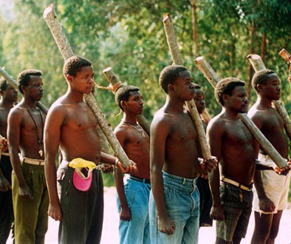
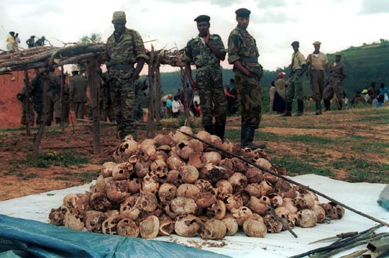
Why? How?
Whose fault?
http://www.global-ethic-now.de/gen-eng/0c_weltethos-und-politik/0c-img/03-friedenspotential/hutu-miliz.jpg
Genocide: the planned extermination of an entire nation, race, or ethnic group.
http://www.unitedhumanrights.org/2009/05/the-genocide-in-rwanda

Slide 7
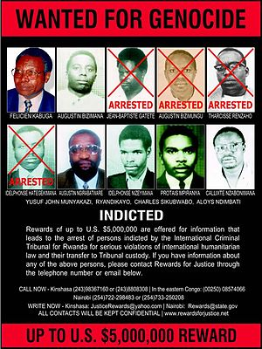
22 executed by Rwanda government
92 charged in
International Criminal
Court
⬥ 33 in prison now
⬥ 11 completed prison time
⬥ 17 appealing conviction thousands convicted through community courts
Who was held Responsible:
http://commons.wikimedia.org/wiki/File:Rwanda_genocide_wanted_poster_2-20-03.jpg
Notes:
As of summer 2012

Slide 8
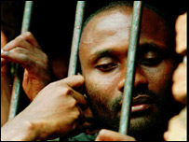
Trials for that many people take too long. Most have been released. But leaders were not released.
http://news.bbc.co.uk/2/hi/africa/4726969.stm
Over 100,000 Hutus were arrested for helping murder people.
Over 100,000 Hutus were arrested for taking part in the genocide.

Slide 9
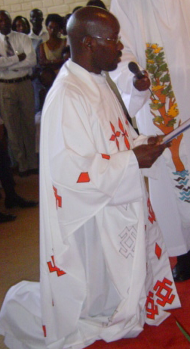

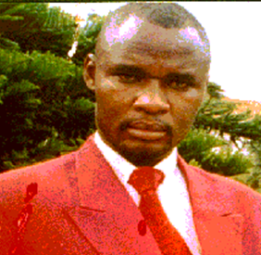
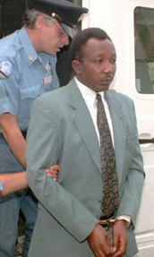
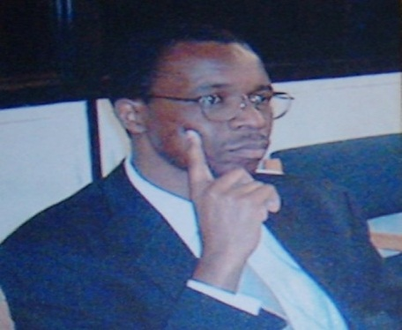
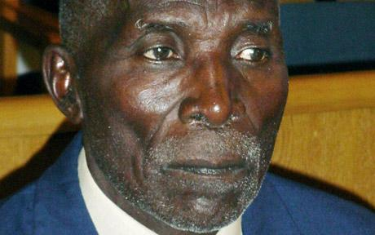
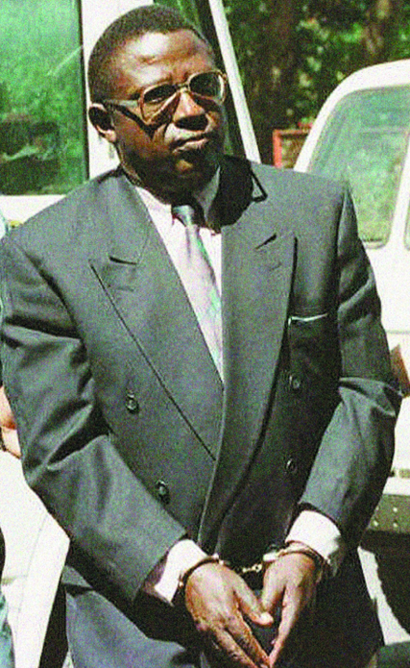
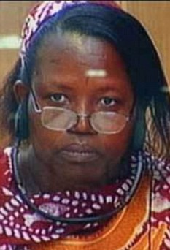
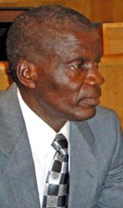
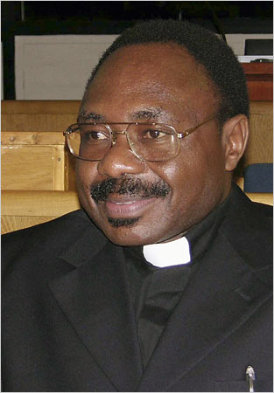
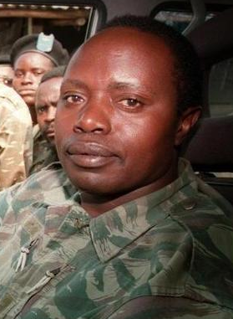
http://www.enoughproject.org/blogs/anniversary-world-first-genocide-conviction
http://www.nytimes.com/2006/12/14/world/africa/14rwanda.html?_r=0
executed
35 years
http://www.whatsondalian.com/news_images/4e055c5d8583f_1.jpg
3 life
sentences
http://www.abayezuwiti.com/Christus%20Voeux.htm
executed
http://journals.worldnomads.com/justinecutler/story/73238/Rwanda/Up-to-the-Genocide
life in
prison
25 years
http://www.unmultimedia.org/radio/english/wp-content/uploads/2011/11/ndahimana-rwanda-convicted.jpg
life In
prison
life in
prison
http://edition.cnn.com/2008/WORLD/africa/12/18/rwanda.tribunal/index.html
30 years
15 years
15 years
http://www.npr.org/blogs/thetwo-way/2011/05/17/136387329/rwandan-general-sentenced-to-prison-for-role-in-1994-genocide
http://i.telegraph.co.uk/multimedia/archive/01670/Yussuf-Munyakazi_1670664c.jpg
http://www.hassanngeze.s5.com/images/hassan_ngeze.gif
Notes:
Pauline Nyiramashuhuko and her son, Arsene Shalom Ntahobali, were both found guilty by the International Criminal Tribunal for Rwanda of atrocities committed in the country's southern Butare region during the 1994 massacre. The 65-year-old - a former families minister - was found guilty of seven out of 11 charges in a trial that lasted 10 years.
As of 28 June 2012 the ICTR has indicted 92 individuals. One individual is currently on trial, 17 are appealing their sentences, and 10 have been acquitted and released from detention. Proceedings against four individuals were terminated after two died and after indictments against two were withdrawn. The cases against ten individuals have been transferred to national jurisdictions, one of which is pending appeal. The Tribunal has finished proceedings against 33 individuals who are currently serving prison sentences, 11 who have finished their sentences and have been released, and three who have died while serving prison sentences. Three individuals remain at large as fugitives.

Slide 10
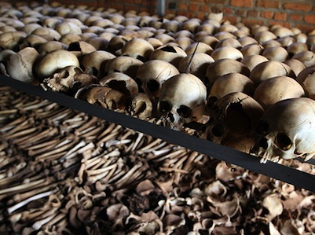
The International Criminal Court has charged 92 people.
But 92 people can’t murder 1,000,000 people.
So who is to blame?

Slide 11
Your assignment:
Read: History of Hutu & Tutsi
Find out what groups were involved in the genocide.
Decide what group bears the most blame.
Back up your choice with evidence!

Slide 12
Ranking Time
1
4
6
2
5
3

Slide 13
So who was mainly to blame?
Ranking Time:
It is never just one group to blame
the Belgian colonizers from Europe?
the Hutu leaders?
the Tutsi refugees?
the Rwanda media?
regular Hutus?
the United Nations & powerful countries?
By yourself,
rank these groups from 1 to 6.
1 = the most blame
6 = the least blame

Slide 14

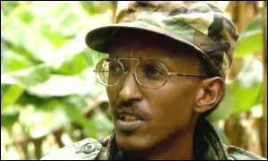
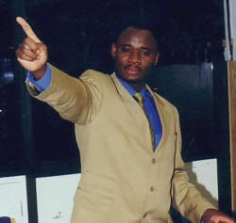
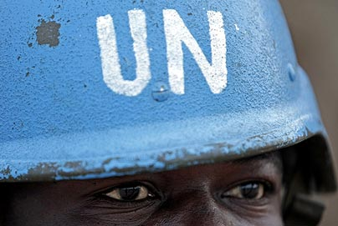
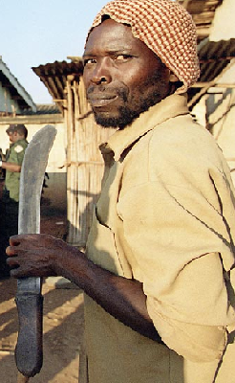
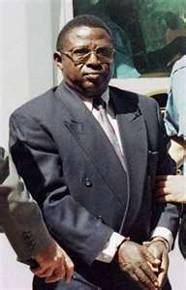
Rwanda media
Belgian colonizers
http://news.bbc.co.uk/2/hi/africa/689405.stm
Tutsi refugee fighters
http://www.arushatimes.co.tz/2003/16/un_tribunal.htm
http://www.tallarmeniantale.com/rwanda.htm
Hutu leaders
Regular Hutus
http://en.igihe.com/news/bagosora-sentenced-to-35-years-in-jail.html
United Nations / powerful countries
http://unyouth.org.nz/blog/wp-content/uploads/2011/09/UN-peacekeeper-404_686391c.jpg
http://ts2.mm.bing.net/images/thumbnail.aspx?q=4973602916139493&id=03a105c201e712e7c1160f5397466b33
http://foreignpolicyblogs.com/2010/08/06/rwanda-still-troubled/
Notes:
Tutsi refugee fighters: President Kagame – a leader of Tutsi rebels and became president after the genocide
Hutu leaders: Col. Bagosora, the « mastermind » behind the genocide – sentenced to 35 years in prison (65 years old)
Media: Hassan Ngeze, publisher of Kangura – 35 years in prison

Slide 15

posting their team’s decision
Janet Hall, Oct. 2012

Slide 16
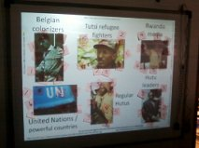
teams’ decisions
Janet Hall, Oct. 2012

Slide 17
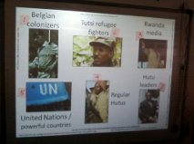
final decision
Janet Hall, Oct. 2012

