Slide 1
SouthWest Asia & North America
 |  | Afghanistan |  |  |  | Mediterranean Sea
 |  | Iran |  |  |  | Black Sea
 |  | Iraq |  |  |  | Caspian Sea
 |  | Lebanon |  |  |  | Persian Gulf
 |  | Israel |  |  |  | Arabian Sea
 |  | Jordan
 |  | Turkey |  |  |  | Mecca, Saudi Arabia
 |  | Syria |  |  |  | Jerusalem, Israel
 |  | Saudi Arabia |  |  |  | Tehran, Iran
 |  | Yemen |  |  |  | Beirut, Lebanon
 |  | Oman |  |  |  | Baghdad, Iraq
 |  | UAE
 |  | Qater |  |  |  | Tigris River
 |  | Bahrain |  |  |  | Euphrates River
 |  | Kuwait |  |  |  | Nile River
 |  | Morrocco
 |  | Egypt
 |  | Algeria
 |  | Tunisia
 |  | Libya
SouthWest Asia & North America
 |  | Afghanistan |  |  |  | Mediterranean Sea
 |  | Iran |  |  |  | Black Sea
 |  | Iraq |  |  |  | Caspian Sea
 |  | Lebanon |  |  |  | Persian Gulf
 |  | Israel |  |  |  | Arabian Sea
 |  | Jordan
 |  | Turkey |  |  |  | Mecca, Saudi Arabia
 |  | Syria |  |  |  | Jerusalem, Israel
 |  | Saudi Arabia |  |  |  | Tehran, Iran
 |  | Yemen |  |  |  | Beirut, Lebanon
 |  | Oman |  |  |  | Baghdad, Iraq
 |  | UAE
 |  | Qater |  |  |  | Tigris River
 |  | Bahrain |  |  |  | Euphrates River
 |  | Kuwait |  |  |  | Nile River
 |  | Morrocco
 |  | Egypt
 |  | Algeria
 |  | Tunisia
 |  | Libya
SouthWest Asia & North America
 |  | Afghanistan |  |  |  | Mediterranean Sea
 |  | Iran |  |  |  | Black Sea
 |  | Iraq |  |  |  | Caspian Sea
 |  | Lebanon |  |  |  | Persian Gulf
 |  | Israel |  |  |  | Arabian Sea
 |  | Jordan
 |  | Turkey |  |  |  | Mecca, Saudi Arabia
 |  | Syria |  |  |  | Jerusalem, Israel
 |  | Saudi Arabia |  |  |  | Tehran, Iran
 |  | Yemen |  |  |  | Beirut, Lebanon
 |  | Oman |  |  |  | Baghdad, Iraq
 |  | UAE
 |  | Qater |  |  |  | Tigris River
 |  | Bahrain |  |  |  | Euphrates River
 |  | Kuwait |  |  |  | Nile River
 |  | Morrocco
 |  | Egypt
 |  | Algeria
 |  | Tunisia
 |  | Libya

Slide 2
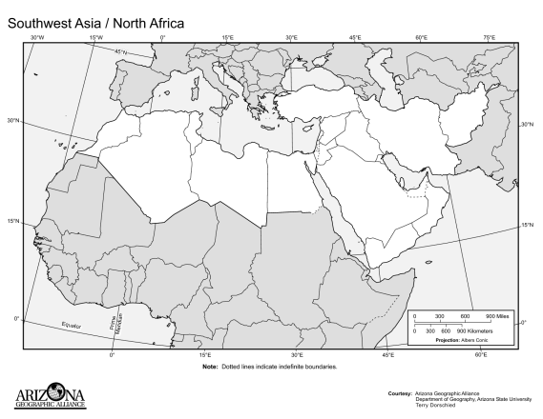
Use Atlas pages 122, 123, 164, 154 to complete the map

Slide 3
Morocco
Egypt
Algeria
Turkey
Tunisia
Libya
Mediterranean Sea
Black Sea
Caspian Sea
Persian Gulf
Arabian Sea
Mecca, Saudi Arabia
Jerusalem, Israel
Tehran, Iran
Beirut, Lebanon
Baghdad, Iraq
Nile River
Tigris River
Euphrates River
Persian Gulf
Afghanistan
Iran
Iraq
Lebanon
Israel
Jordan
Turkey
Syria
Saudi Arabia
Yemen
Oman
UAE – United Arab Emeritus
Qatar
Bahrain
Kuwait

Slide 4
SouthWest Asia & North Africa
 |  | Afghanistan |  |  |  | Mediterranean Sea
 |  | Iran |  |  |  | Black Sea
 |  | Iraq |  |  |  | Caspian Sea
 |  | Lebanon |  |  |  | Persian Gulf
 |  | Israel |  |  |  | Arabian Sea
 |  | Jordan
 |  | Turkey |  |  |  | Mecca, Saudi Arabia
 |  | Syria |  |  |  | Jerusalem, Israel
 |  | Saudi Arabia |  |  |  | Tehran, Iran
 |  | Yemen |  |  |  | Beirut, Lebanon
 |  | Oman |  |  |  | Baghdad, Iraq
 |  | UAE
 |  | Qatar |  |  |  | Tigris River
 |  | Bahrain |  |  |  | Euphrates River
 |  | Kuwait |  |  |  | Nile River
 |  | Morrocco
 |  | Egypt
 |  | Algeria
 |  | Tunisia
 |  | Libya
SouthWest Asia & North Africa
 |  | Afghanistan |  |  |  | Mediterranean Sea
 |  | Iran |  |  |  | Black Sea
 |  | Iraq |  |  |  | Caspian Sea
 |  | Lebanon |  |  |  | Persian Gulf
 |  | Israel |  |  |  | Arabian Sea
 |  | Jordan
 |  | Turkey |  |  |  | Mecca, Saudi Arabia
 |  | Syria |  |  |  | Jerusalem, Israel
 |  | Saudi Arabia |  |  |  | Tehran, Iran
 |  | Yemen |  |  |  | Beirut, Lebanon
 |  | Oman |  |  |  | Baghdad, Iraq
 |  | UAE
 |  | Qatar |  |  |  | Tigris River
 |  | Bahrain |  |  |  | Euphrates River
 |  | Kuwait |  |  |  | Nile River
 |  | Morrocco
 |  | Egypt
 |  | Algeria
 |  | Tunisia
 |  | Libya

