Slide 1
ISRAELI-PALESTINIAN CONFLICT
UNITED NATIONS PERSPECTIVE

Slide 2
GEOLOGICAL HISTORY
LAND FORMATION
Plate tectonics
Nubia and Asia plates collide
Folding effect
Dead Sea – Lowest place on earth
Notes:
We have discussed tectonic plates before, only this time it is not in the Ring of Fire.
The Nubia plate represents Africa and it is folding under the Asia plate.
At the bottom of this fold is the lowest place on earth.

Slide 3
HISTORY
ANCIENT
TURN OF CENTURY
1948
1967
TODAY
Notes:
Outline of the history.
We will see that conflict has been present throughout the land and throughout time.

Slide 4
ANCIENT HISTORY
Noah and the Ark rested on the mountains of ARARAT
Notes:
Sacred Text describes the end of the flood and beginning (over) of mankind.
Ancient texts also describe the flood in this area.

Slide 5
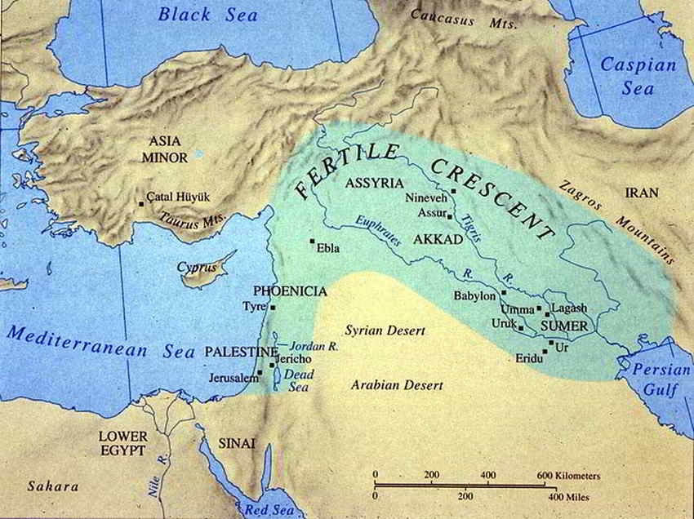
Ancient Palestine
Notes:
Note Palestine on the West edge of the Fertile Crescent.
Note also the biblical battleground.
This is where the famous David and Goliath was fought.

Slide 6
ROUTES FOR TRADE AND COMMUNICATION
Notes:
The Middle East is certainly in the middle.
I ask the students the value of being located in the center.
This is also a good discussion for how the story of creation came out of the cradle of civilization in the Fertile Crescent.
The epic tales of earliest civilization line up with the epic story of the Hebrew ancient text.

Slide 7
Israel in Timeline
STATEHOOD
Notes:
Although Israel has a long and biblical history, it only recently gained statehood.
This is important to the conflict because Israelis talk about historical rights.
Palestinians also talk about historical rights

Slide 8
1948
Based on the Balfour Declaration the United Nations created the state of Israel in 1948.
Immediate fighting continued and Israel prevailed.
Notes:
The British controlled Palestine and declared a need for a Jewish State.
The United Nations agreed and formed the State.
Fighting commenced and Fighting continues.

Slide 9
Surrounded by enemies
Notes:
Each of the enemies of Israel are not just enemies; they do not believe in Israel’s right to exist.
Many Arab Nations shown here have publically declared that Israel does not have the right to exist.
The substantial threat to Israel helps explain the immense importance of security and the strength of the Israeli Defense Force (IDF)

Slide 10
First Prime Minister David Ben Gurion
Notes:
David Ben Gurion was a war hero.
As a Jew he was deeply religious yet he was a realist as well.
He was so instrumental to the securing of land for Israel they named the major airport in Tel Aviv after him.

Slide 11
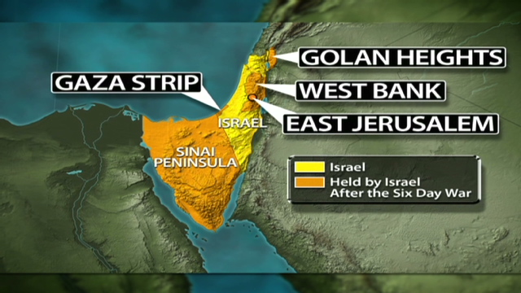
1967
WAR
Israel wins territory
Sets up current borders
Notes:
Israel defeated all of her enemies in the 1967 war. The enemies were not just the Palestinians but Egypt, Jordan, Lebanon and Syria.
Israel has since given up the Sinai peninsula to Egypt.

Slide 12
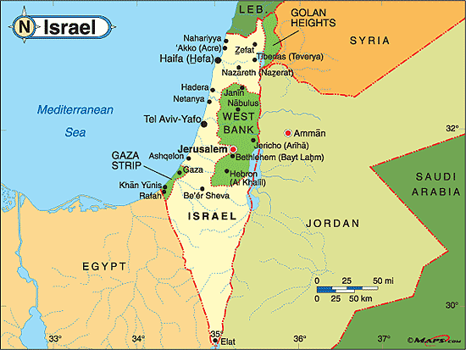
CURRENT
Gaza Strip
West Bank
Golan Heights
Notes:
Israel is still a fractured country with no clean border.
Peace is made with Egypt and Jordan.
Technically there is only a ceasefire between Syria and Israel on the Golan Heights.
The Palestinians have autonomous areas in the Gaza Strip and West bank. What this means is that they have their own government but they still must adhere to Israeli rule. They share the Israeli currency, the Sheckel.

Slide 13
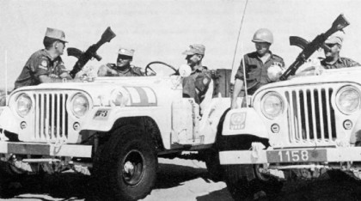
United Nations deployment
Notes:
Almost every country has served by peacekeeping in this region.

Slide 14
Armies and Air Forces of many countries
Notes:
The armies and Air Forces maintain peace between Egypt and Syria by occupying “green zones” between them and Israel.

Slide 15
Notes:
American forces are shown here serving on the Sinai peninsula.

Slide 16
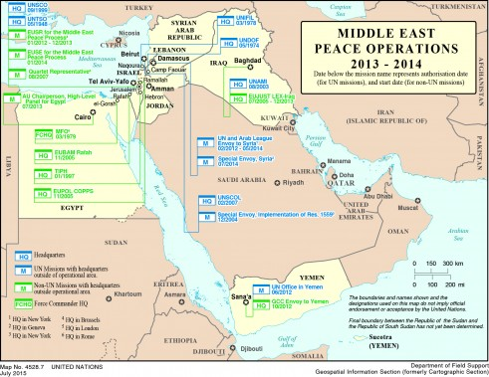
Notes:
The middle East remains at the center.

Slide 17
Refugees
Following 1967 War, Palestinians moved into temporary refugee camps.
They have remained there
Major issue for peace
Notes:
The issue of refugees can be thought of as a difficult problem. Their return would seriously upset the population ratios and affect voting solutions.

Slide 18
Notes:
The temporary condition remains. The refugees do need to have a plan of return.

Slide 19
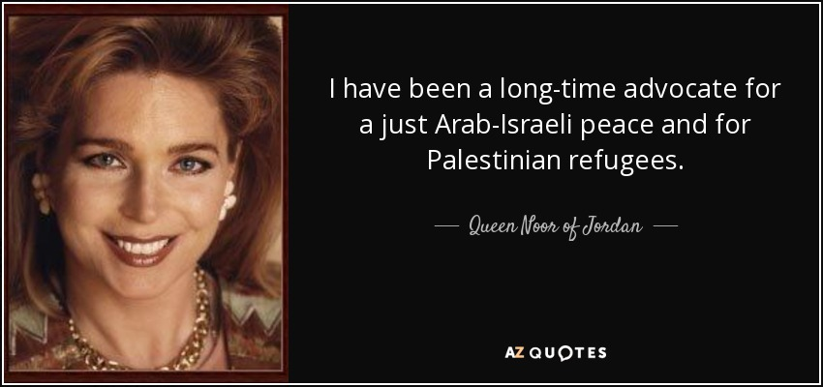
Notes:
The Queen of Jordan is herself a Palestinian refugee

Slide 20
Peace?
Notes:
This is a good graphic to simplify our discussion.

Slide 21
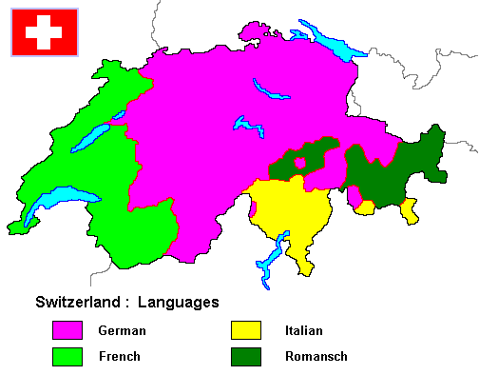
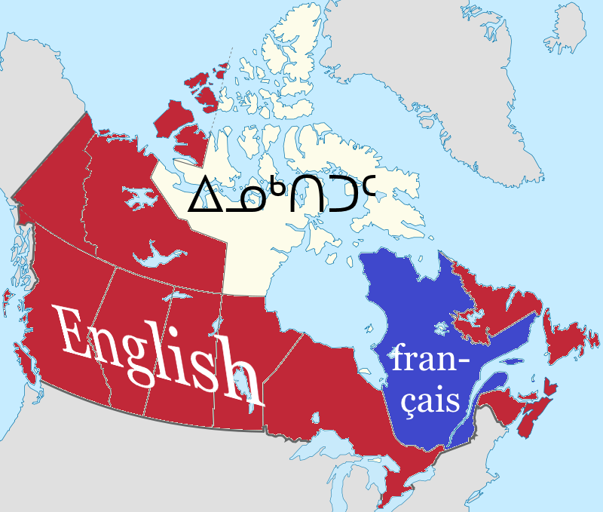
EXAMPLES
SWITZERLAND
CANADA
FOUR LANGUAGES
SEPARATE CULTURES
REPRESENTATION
TWO LANGUAGES
SEPARATE CULTURES
REPRESENTATION
Notes:
A couple of examples to assist the discussion

Slide 22
Lets solve this
PEACE
SECURITY
REFUGEE
GOVERN
LAND
Notes:
Allow a discussion using each piece of the Venn diagram and see what they come up with.
Keep things simple with concepts.

