Slide 1
Introduction to the Middle East
Absent students: Copy notes from the power point onto page 94 in your
INB. On page 95, answer the questions from pages 28, 29, and 30 of the powerpoint.

Slide 2
Now, think about where these images come from.
What sources of information have you been exposed to that contribute to your images of the Middle East?
How have TV shows, news, novels, movies, and other sources influenced your views of the Middle East?
Notes:
I use this slide to guide thoughts about where students got their impressions of what the Middle East is like. This is basically just a warm-up discussion.

Slide 3
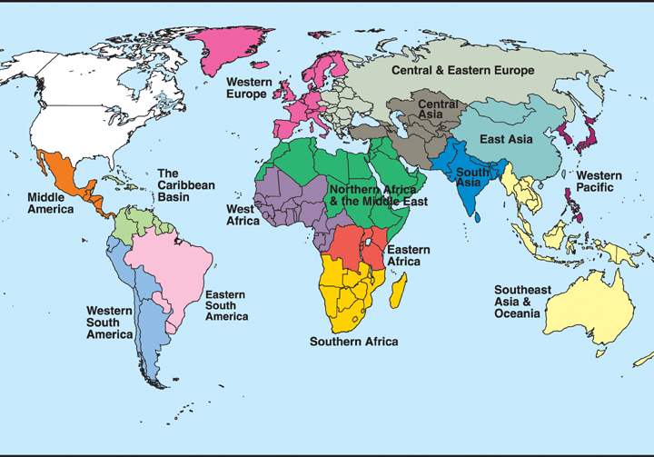
Intro to the Middle East
---AKA “Southwest Asia” or the “Near East”
Notes:
On this slide, I discuss the Middle East as a region. I explain that different people have different definitions of the Middle East, different names for the region, and different thoughts about what countries should be included. I explain which countries we are mainly discussing for our 7th grade geography purposes (All of northern Africa to Afghanistan/Pakistan).

Slide 4
Big Ideas to Focus on:
Where is the Middle East located?
What are some things that make the Middle East unique and what is important about the history of the Middle East?
What are some issues that the Middle East is currently facing?
Notes:
This is just to guide the students’ thinking as we go through the powerpoint.

Slide 5
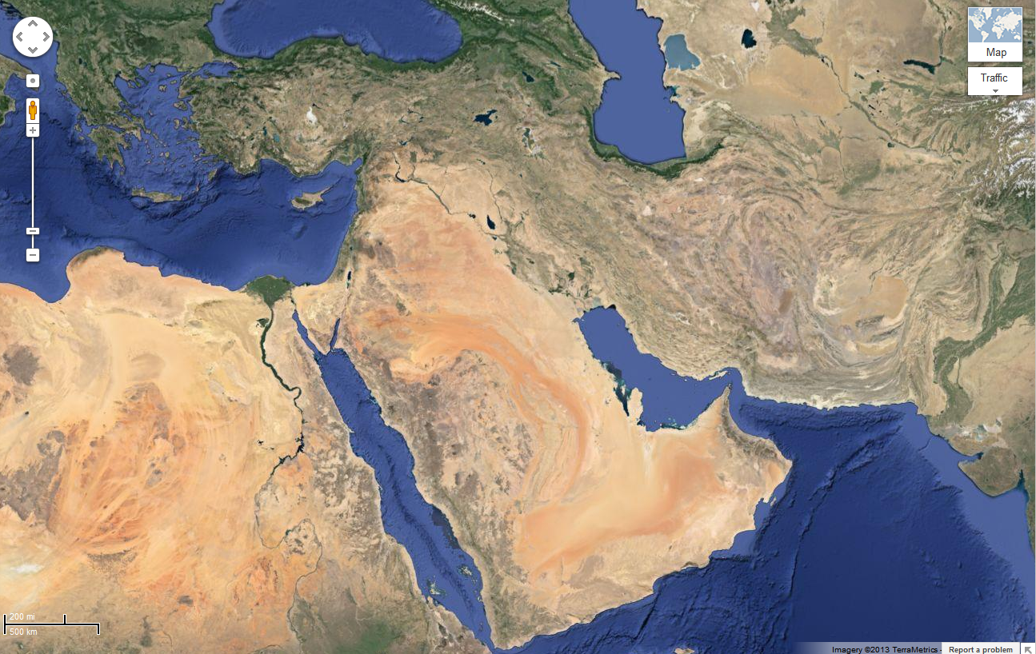
Notes:
I like to use the actual Google Earth program in my class (because kids love to see it zoom), but if you don’t have access to it or don’t have time, you could always use this screenshot.
At this point in the year, students should be able to tell me a lot about a region just based on a satellite image. I like to ask them lots of questions to make sure they remember their skills. Possible questions include:
What kind of picture is this? Or Is this an aerial photo or a satellite image? What’s the difference? How can you tell? (satellite image)
What can you tell me about the Middle East just based on this picture? (There are lots of deserts because it looks sandy, it looks like it’s a relatively flat region, they have a lot of coastline, the northern part near Turkey is more green and probably has more fertile land, you can see a few rivers, etc.)
What direction does the Nile River flow? How can you tell? (North because it empties into the Mediterranean and you can see the delta)
Where do you think most people in the Middle East live? (Near the coasts, in Turkey, along the banks of rivers, where it is green, etc.)
Which areas do you think are least populated? (Middle of Saudi Arabia, everywhere it looks really brown, inland areas, etc.)
You can also simply draw x’s or something on the map and ask them which body of water is this, what country do you think I’m in, etc.

Slide 6
Where is the Middle East located?
Let’s name some countries that are in the Middle East:
Notes:
More of a warm-up to make sure students were paying attention to the map we completed previously and that they know which area of the world we are talking about.

Slide 7
The Middle East Today: Political Map
Some people say it looks like an angel. What do you think? .
Notes:
There is a whole lesson about this angel concept, but I usually just show my kids a picture and they make the connection without talking about which country makes up which of the angel’s body parts and all of that extra stuff.

Slide 8
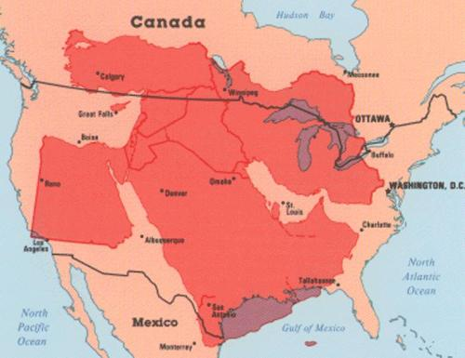

Slide 9
Notes:
I use this map to practice our map skills as I like to do for every region. Some questions could include:
Which country has the highest average elevation? (Iran)
What body of water is directly west of Saudi Arabia? (Red Sea)
Name two deserts located in the Middle East. (Rub Al Khali, An Nafud, Sahara, Great Salt Desert, etc.)
Which areas on the map do you think have a high population density? (Iraq because it has two major rivers, near the coast, areas in green with lower elevations, etc.)
What rivers flow into the Persian Gulf? (Euphrates & Tigris)
The question possibilities go on and on.

Slide 10
Birthplace of Civilization
The 1st ancient civilizations & possibly even human life itself originated here!
Mesopotamia
Mesopotamia—Greek for “land between the rivers”
Covers Iraq, parts of Syria, Turkey
Region called Fertile Crescent due to its shape
& the fertile soil
Notes:
http://www.timemaps.com/history/middle-east-500ad

Slide 11
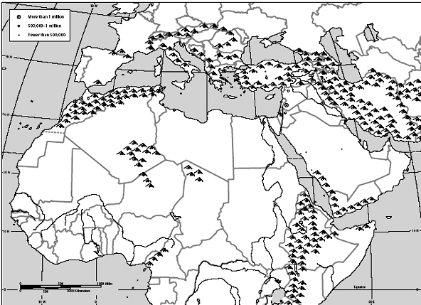
Fertile Crescent
FUN FACT:
Cuneiform, the earliest form of writing on clay tablets, was recorded in Mesopotamia

Slide 13
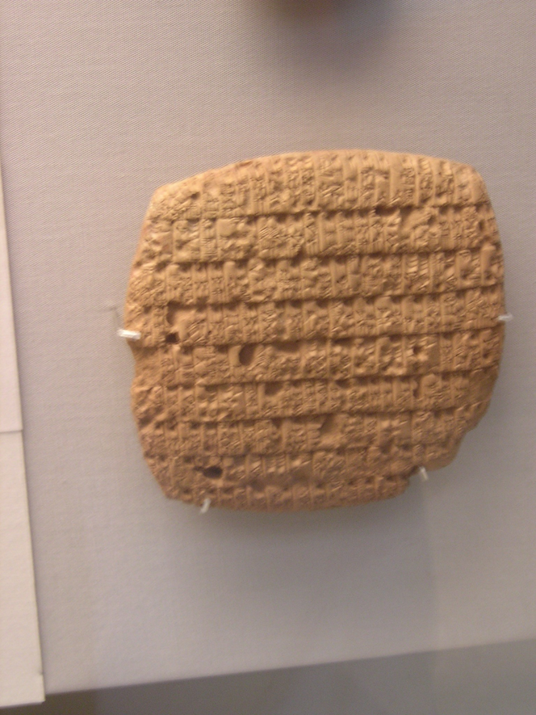

Slide 14
The Fertile Crescent
Most of SW Asia is desert. Two major rivers, the Tigris and the Euphrates, run through what is known as the Fertile Crescent.
Years of flooding has made the land surrounding the rivers fertile. Irrigation is also used to produce more fertile soil for crops.

Slide 15
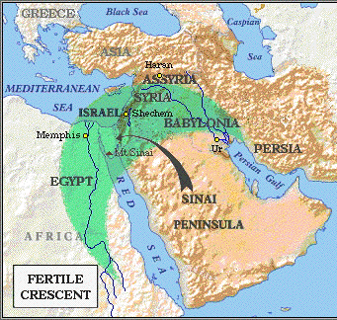
Ancient civilizations such as:
-Mesopotamia
-Babylon
-Assyria
-Egypt
-Persia
The Fertile Crescent
Timemap of the ME

Slide 16
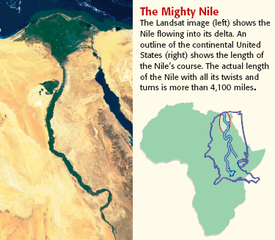
The Mighty Nile River: Longest River in the World
Fun Fact: The Mississippi River is 2,320 miles long

Slide 17
Religion in the Middle East
What 3 major religions were started in the area?
Christianity, Islam, Judaism
Jerusalem – A World’s Marvel
Notes:
https://www.youtube.com/watch?v=-D0HmtGlqJM

Slide 18
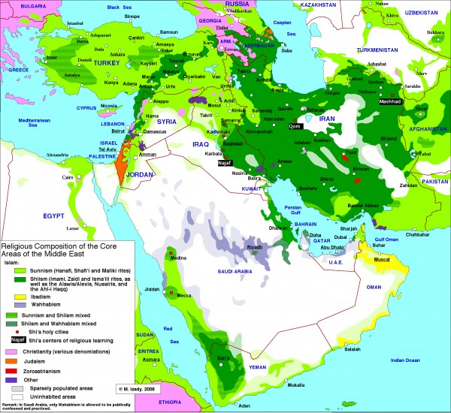
Religions in the Middle East
Light green = Sunni Islam
Dark green = Shi‘ah Islam
Middle green = Mix of both
Pink = Christianity
Orange = Judaism
White/Gray = Spaely populated or uninhabited
Everything Else = Other
Notes:
As always, I use this map to practice our map skills. Some possible questions include:
What is the most predominant religion in the Middle East? (Islam)
Which country has the largest amount of Jews? (Israel)
What branch of Islam is most popular in Turkey? (Sunni)
Which country do the majority of Shi’ah Muslims live in? (Iran)

Slide 19
Religion in the Middle East
What 3 major religions were started in the area?
Christianity, Islam, Judaism
How do you think having all of these religions represented in the area affects the region?
Leads to cultural diversity
Can lead to conflict and violence, especially over land disputes

Slide 20
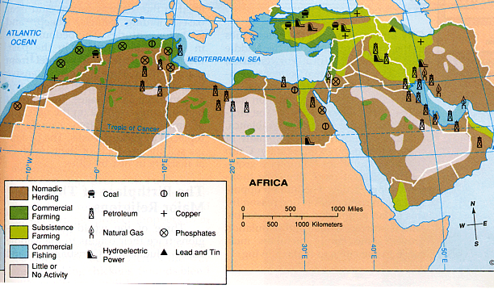
The Natural Resources of the Middle East
*Phosphates are used for farming & manufacturing new products
Notes:
Possible Questions:
What is the most abundant natural resource? (oil)
What activity lines the Nile River? (subsistence farming)
In what areas is commercial farming located? (Near the coasts, lower elevations, northern Africa & Turkey)
Why do you think little or no activity takes place in Saudi Arabia? (It’s mostly barren desert)
What does the plus sign represent on the map? (copper)
What activity is most popular in the Middle East? (Nomadic herding)
Which body of water is surrounded by the most oil? (Persian Gulf)
Based on this map alone, which countries do you think might be the poorest in the region? (Yemen, Oman, Saudi Arabia)---As long as the students can make an argument, I’m satisfied.

Slide 21
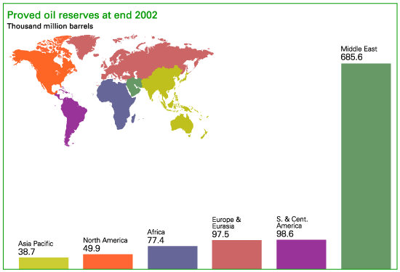
World Oil Reserves
Notes:
I love pointed out the discrepancy between the size of the Middle East and how much oil they have.

Slide 22
Issues/Problems Facing the Middle East
Lack of water
Religious Conflict/Land disputes
Oil
Terrorism/Extremism
Equality for women

Slide 23
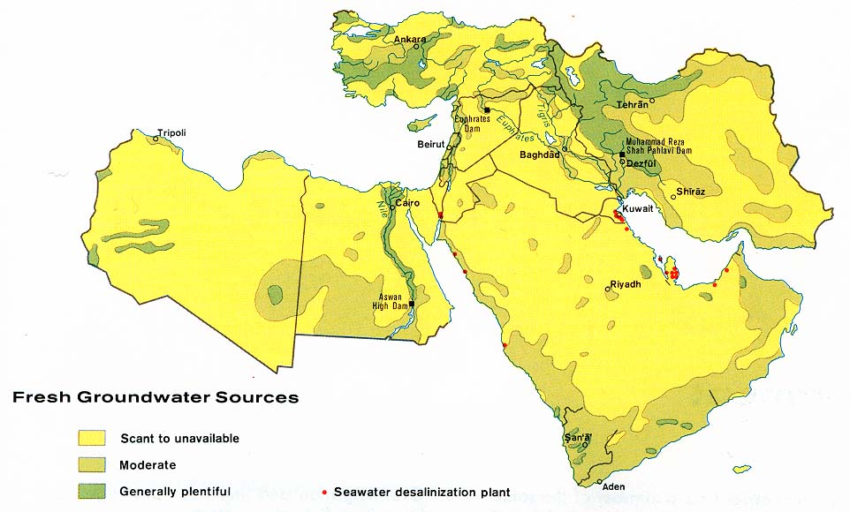
Fresh Water Sources
Notes:
I like to ask discussion questions such as
How do you think having different levels of access to water affect relationships in the region? Do you think it creates more conflict or cooperation? Why?
What are some possible solutions for countries like Libya that have very few water sources?
What is one possible conflict that could arise between Turkey and Iraq?

Slide 24
~300 million people live in the Middle East
~311,591,917 live in the U.S.
Notes:
If you’re not tired of questions yet:
What is the most densely populated city in the Middle East? (Cairo)
What is the most densely populated city in Iran? (Tehran)
How can you relate the overall population patterns to what we know about the physical geography of the Middle East? (Saudi Arabia is mostly desert and they have less densely populated areas, The Nile River valley is extremely densely populated, the green and fertile land in Turkey attracts large amounts of people, etc.)

Slide 25
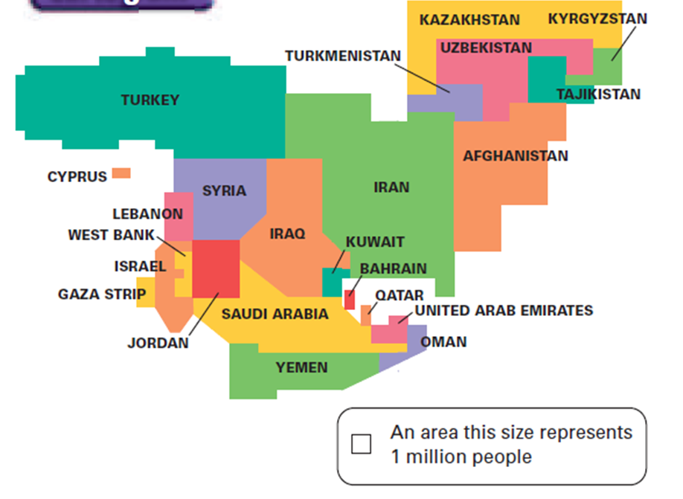
What is this 2nd kind of map called?
Notes:
Cartogram-a map that takes the shape of a second statistic such as population, GDP, number of exports, etc.

Slide 26
What statistic is the cartogram measuring?
Notes:
Population

Slide 27
Name a country that has a low population for its large land size.
Notes:
Saudi Arabia, Kazakhstan, etc.
(Looking for a country that’s big on the map, but small on the cartogram)

Slide 28
Do any countries seem to have a high population density?
Israel, Lebanon, Jordan, etc.
Notes:
Israel, Lebanon, Jordan, etc.
(Looking for a country that’s small on the map but big on the cartogram)

Slide 29
 | Population | Area | Per Capita Income | Life Expectancy | TVs per 1,000
Afghanistan | 29.9 million | 250,001 | $800 | 42.9 | 14
Iran | 68 million | 636,296 | $7,700 | 70.0 | 154
Iraq | 26.1 million | 168,754 | $3,500 | 687 | 82
Israel | 6.3 million | 8,019 | $20,800 | 79.3 | 328
Jordan | 5.8 million | 35,637 | $4,500 | 78.2 | 83
Kuwait | 2.3 million | 6,880 | $21,300 | 77.0 | 480
Lebanon | 3.8 million | 4,015 | $5,000 | 72.6 | 355
Oman | 3 million | 82,031 | $13,100 | 73.1 | 575
Qatar | 863,100 | 4,416 | $23,200 | 73.7 | 866
Saudi Arabia | 26.4 million | 756,985 | $12,000 | 75.5 | 263
Syria | 18.4 million | 71,498 | $3,400 | 70.0 | 68
Turkey | 69.7 million | 301,383 | $7,400 | 72.4 | 328
UAE | 2.6 million | 32,000 | $25,200 | 75.2 | 309
Yemen | 20.7 million | 203.850 | $800 | 61.8 | 286
United States | 295.7 million | 3,718,710 | $40,100 | 77.7 | 844
Notes:
Look at the data for the Middle East. What general statements can you make about these countries? Try to come up with at least 3 of your own.
(Ex. Most countries in the Middle East have less than 400 TVs per 1,000 people.)
(Ex. Most countries in the Middle East have a lower life expectancy than the U.S.)
(Ex. Wealthier countries in the U.S. tend to be small and located near the Persian Gulf)

Slide 30
Quick Review from Yesterday
What other names can you call the Middle East region?
What are some things that make the Middle East unique? (5)
Name a civilization that got started in the Middle East.
What is the name of the region that’s super fertile, shaped like a moon, and was the origin of all humankind?
Notes:
Just in case it takes more than 1 day to complete this powerpoint.

Slide 31
Open-Ended Review Questions to Check for Understanding
5) Which country might you want to live in the Middle East? And Why?
6) Which country might you NOT want to live in and why?
Notes:
Just in case you find them to be useful.

Slide 32
RSA: Leaving on a Jet Plane….
What should you pack
What is it like when you step off the plane
What are the people dressed like
What is the weather like
What do your surroundings look like
How does it compare to home.

Slide 33
DUMP SLIDES

Slide 34
Today Is… 8 January 2013 | Imagine a trip to the Middle East. What do you think you would see as you get off the plane & travel through the region? What types of landforms would you see? Where is the water, and what form does it take? How are the people dressed? What do the buildings look like? PAGE 74- notebook
Agenda Intro to the Middle East Israel/Egypt/Saudi Arabia RSA |  | Last Class: Middle East Map Next Class: Middle East Intro
 | SWBAT Locate the Middle East and describe what makes the area unique, why their history is important, and describe some issues the region is currently facing.
Notes:
I have students complete this bell ringer in their notebooks at the beginning of class. Once I feel students have had enough time to think about and answer the question, I ask a few of them to share their answers with the class.

Slide 35
What are some things that make the Middle East unique and what is important about the history of the Middle East?

Slide 36
What are some issues that the Middle East is currently facing?

